Slide 1
Paired Data

Slide 2
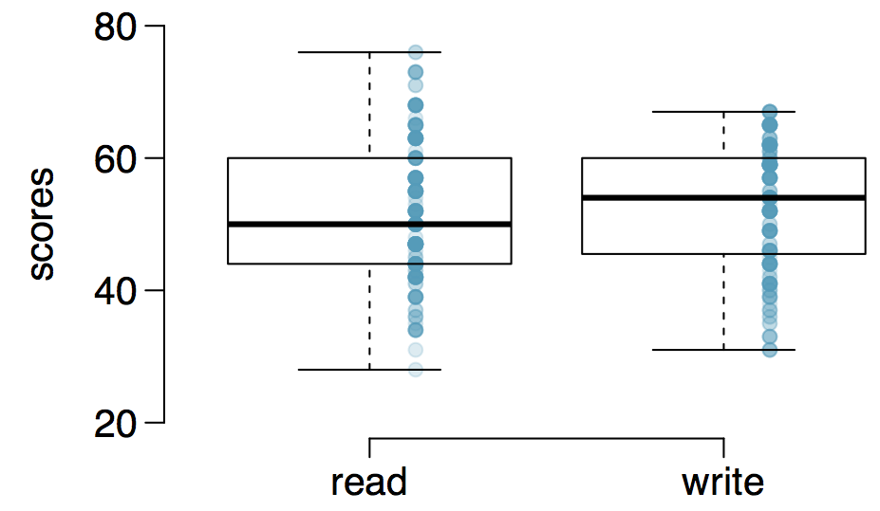
Paired observations
200 observations were randomly sampled from the High School and Beyond survey. The same students took a reading and writing test and their scores are shown below. At a first glance, does there appear to be a difference between the average reading and writing test score?

Slide 3
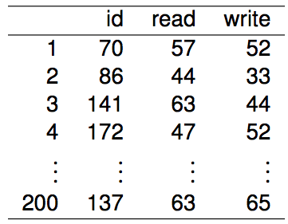
Paired observations
The same students took a reading and writing test and their scores are shown below. Are the reading and writing scores of each student independent of each other?

Slide 4
Analyzing paired data
When two sets of observations have this special correspondence (not independent), they are said to be paired.

Slide 5
Analyzing paired data
When two sets of observations have this special correspondence (not independent), they are said to be paired
To analyze paired data, it is often useful to look at the difference in outcomes of each pair of observations
diff = read - write

Slide 6
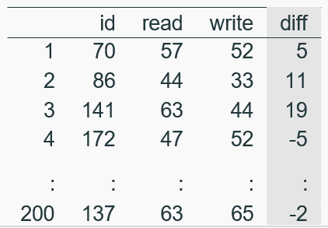
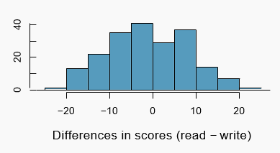
Analyzing paired data
When two sets of observations have this special correspondence (not independent), they are said to be paired
To analyze paired data, it is often useful to look at the difference in outcomes of each pair of observations
diff = read - write
It is important that we always subtract using a consistent order

Slide 7


Parameter and point estimate
Parameter of interest: Average difference between the reading and writing scores of all high school students
Point estimate: Average difference between the reading and writing scores of sampled high school students

Slide 8


Setting the hypotheses
What are the hypotheses for testing if there is a difference between the average reading and writing scores?
H₀ : Average reading and writing scores are equal.
H_{A} : Average reading and writing scores are different.

Slide 9
Nothing new here
The analysis is no different than what we have done before
We have data from one sample: differences.
We are testing to see if the mean is 0.

Slide 10
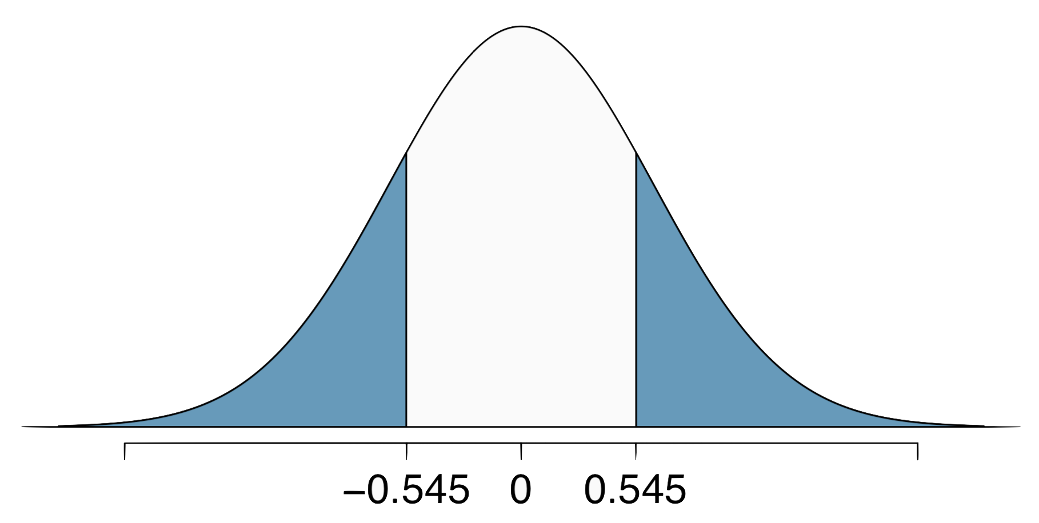
Calculating the test-statistics and the p-value
The observed average difference between the two scores is -0.545 points and the standard deviation of the difference is 8.887 points. Do these data provide convincing evidence of a difference between the average scores on the two exams? Use α = 0.05

Slide 11




Calculating the test-statistics and the p-value
The observed average difference between the two scores is -0.545 points and the standard deviation of the difference is 8.887 points. Do these data provide convincing evidence of a difference between the average scores on the two exams? Use α = 0.05
Since p-value > 0.05, fail to reject, the data do not provide convincing evidence of a difference between the average reading and writing scores.

Slide 12
HT ↔ CI
Suppose we were to construct a 95% confidence interval for the average difference between the reading and writing scores. Would you expect this interval to include 0?
yes
no
cannot tell from the information given

Slide 13
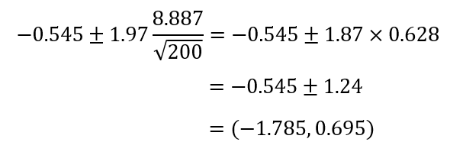
HT ↔ CI
Suppose we were to construct a 95% confidence interval for the average difference between the reading and writing scores. Would you expect this interval to include 0?
yes
no
cannot tell from the information given

